Slide 1
INTE 22283 – Mobile Application Development
Week 4: Mobile Application Architecture
Sammani Maddumahewage
Lecturer (Probationary)
BSc (Hons) in Information Technology

Slide 2
Today's Learning Outcomes
Explain the role of software architecture in mobile application development
Describe the MVC (Model-View-Controller) architectural pattern
Describe the MVVM (Model-View-ViewModel) architectural pattern
Explain Android application components: Activities, Services, Broadcast Receivers, Content Providers
Describe the Activity and Fragment lifecycle
Discuss state management and data binding in mobile applications
Apply separation of concerns when structuring a mobile project
Implement a simple multi-screen application using an architectural pattern

Slide 3
Recap and Framing
Previous weeks: We chose a platform approach and built our first running app
This week: We address how to structure the code inside an app so it stays maintainable as it grows beyond a single screen
Why this matters now: Without a clear architecture, even a small app's code quickly becomes tangled and difficult to test or extend

Slide 4
Why Software Architecture Matters
Definition: Software architecture is the high-level structure of a system — how its components are organized and how they interact
Without architecture: UI code, business logic, and data access become mixed together, making the app hard to test, debug, and extend
With clear architecture: Each part of the app has a well-defined responsibility, so changes in one area don't unexpectedly break another
Mobile-specific pressure: Mobile apps must also gracefully handle lifecycle events (rotation, backgrounding) — architecture patterns provide a disciplined way to do this consistently

Slide 5
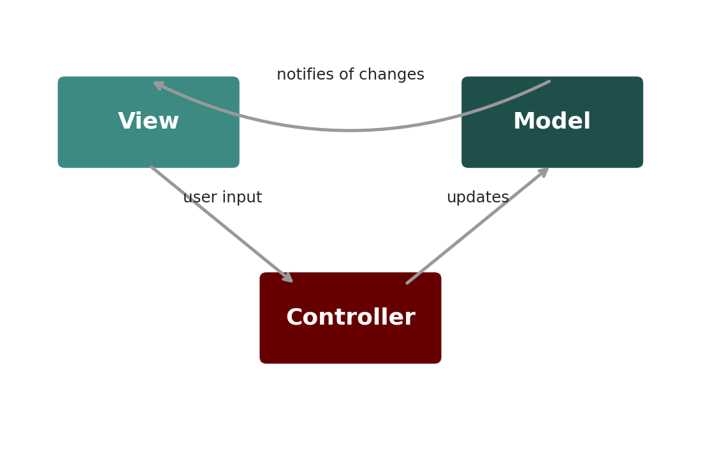
MVC: Model-View-Controller
[ INSERT IMAGE ]
Model: Holds the application's data and business logic, independent of the UI
View: Displays data to the user and captures user input
Controller: Receives input from the View, updates the Model, and refreshes the View
Figure 1: The Controller mediates between the Model (data) and the View (UI)

Slide 6
MVC in Android Practice
Typical mapping: The Activity or Fragment often plays the role of both View and Controller, while separate classes represent the Model
Strength: Simple to understand and quick to implement for small apps
Common weakness: Activities tend to grow into “massive” classes handling both UI logic and control logic, making testing difficult
Why this matters: This weakness is the main motivation behind MVVM, which we examine next

Slide 7
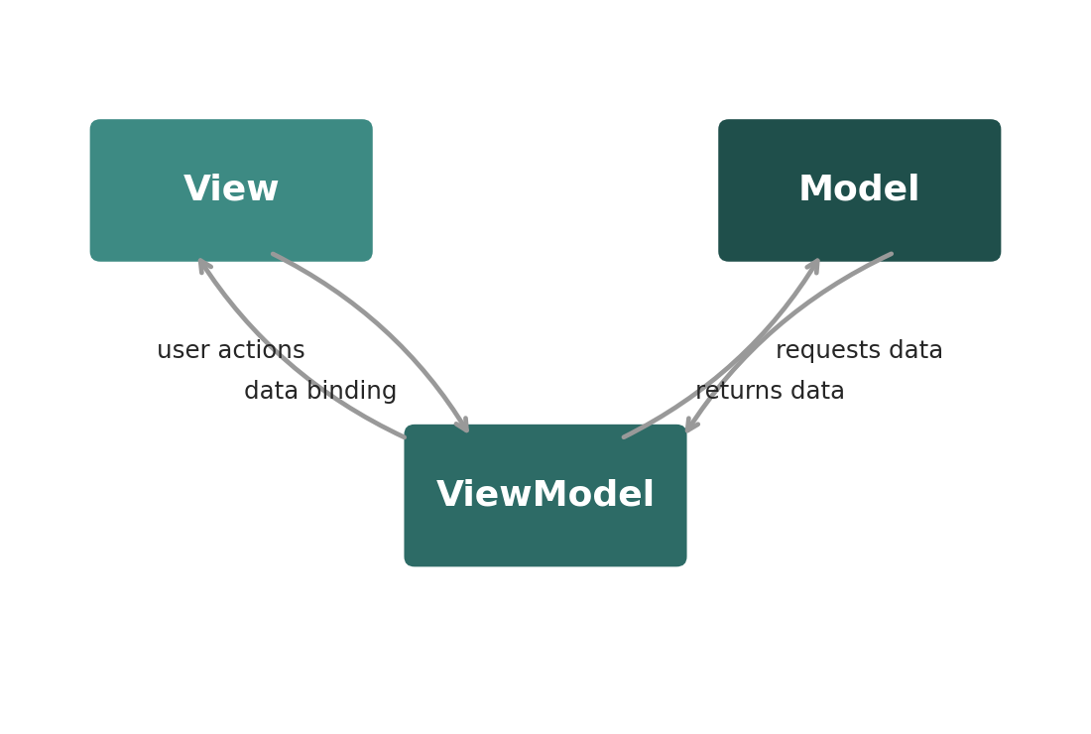
MVVM: Model-View-ViewModel
[ INSERT IMAGE ]
Model: Same role as in MVC — application data and business logic
View: Observes the ViewModel and updates automatically when its data changes
ViewModel: Holds UI-related state and logic, exposing observable data without referencing the View directly
Figure 2: The ViewModel exposes data the View observes, without holding a direct reference to the View

Slide 8
Why MVVM Improves on MVC for Mobile Apps
Lifecycle survival: Android's ViewModel class is specifically designed to survive configuration changes like screen rotation, solving a common MVC pain point
Testability: Because the ViewModel doesn't directly reference UI elements, its logic can be unit-tested without running the full UI
Data binding: The View can automatically reflect ViewModel changes through observable data structures (e.g., LiveData or StateFlow), reducing manual update code
Trade-off: MVVM introduces more initial structure and concepts to learn than MVC, which can feel like overhead for very simple apps

Slide 9
MVC vs. MVVM at a Glance
Table 1: Comparing the two patterns across key dimensions
Aspect | MVC | MVVM
View-logic coupling | Tighter (Activity often does both) | Looser (ViewModel independent of View)
Testability | Harder | Easier
Survives rotation | Not by default | Yes, with ViewModel
Learning curve | Lower | Slightly higher
Best for | Small, simple apps | Apps expected to grow and scale

Slide 10
The Four Core Android Components
Activities
Represent a single screen with a user interface; the building block of user-facing app navigation
Services
Run operations in the background without a UI, such as playing music or syncing data
Broadcast Receivers
Listen for and respond to system-wide or app-wide announcements (e.g., battery low, network changed)
Content Providers
Manage shared access to structured data, enabling controlled data sharing between apps

Slide 11
How the Four Components Work Together
Example scenario: A messaging app receives a new message while running in the background
Broadcast Receiver: Detects the incoming message notification from the system
Service: Downloads the message content in the background, even if the app isn't currently open
Content Provider: Stores the message in a shared database accessible to other parts of the app (or other apps, if permitted)
Activity: Displays the message to the user once they open the app

Slide 12
Recap: The Activity Lifecycle
From Week 2: Activities move through Created → Started → Resumed → Paused → Stopped → Destroyed states
Why we revisit it here: Architecture patterns like MVVM exist specifically to make managing this lifecycle easier and less error-prone
Key architectural insight: Any data the user shouldn't lose must live somewhere that survives the Activity's destruction — which is exactly what a ViewModel provides

Slide 13
The Fragment Lifecycle
What is a Fragment?
A reusable portion of UI that lives inside an Activity, enabling modular, multi-pane, or tabbed interfaces
Fragment lifecycle is layered on the Activity's
Fragments have their own onCreateView(), onViewCreated(), onDestroyView() callbacks in addition to Activity-style callbacks
Why Fragments add complexity
A Fragment's view can be destroyed and recreated independently of the Fragment object itself, a common source of subtle bugs
Practical implication
Using a ViewModel scoped to the Fragment (or shared with its parent Activity) avoids holding stale view references

Slide 14
State Management in Mobile Apps
Definition: The practice of tracking and updating the data that determines what the UI currently displays
UI state: Information directly tied to what's on screen right now (e.g., whether a loading spinner is visible)
Persistent state: Data that must survive beyond the current screen session (e.g., user login status, saved drafts)
Why it's harder on mobile: Frequent lifecycle events (rotation, backgrounding, low-memory termination) mean state can be lost far more easily than in a desktop application

Slide 15
Data Binding
Definition: A technique that automatically synchronizes UI elements with underlying data, removing the need to manually update each view
Without data binding: Developers must write explicit code every time data changes to update each affected UI element
With data binding: The View observes data (e.g., from a ViewModel) and updates itself automatically when that data changes
Connection to MVVM: Data binding is what makes the View-ViewModel relationship in MVVM practical and low-boilerplate

Slide 16
Separation of Concerns in Practice
Principle: Each part of a system should have one clear responsibility, and should not need to know the implementation details of other parts
UI layer: Displays data and forwards user actions; contains no business logic
Logic layer (ViewModel): Coordinates what data should be shown and how user actions should be handled
Data layer (Model / Repository): Handles where data actually comes from — local database, network, or cache — hidden behind a simple interface
Benefit: Each layer can be changed, tested, or replaced independently — for example, swapping a local database for a cloud one without touching the UI

Slide 17
Worked Example: A To-Do List App
Without architecture: The Activity directly creates, stores, and displays to-do items all in one class — a single 500-line file
Applying MVVM: A TodoViewModel holds the current list and exposes it as observable data; a TodoRepository (Model) manages storage; the Activity/Fragment (View) just displays what the ViewModel provides
Result of separation: The storage mechanism could change from an in-memory list to a database without changing a single line of UI code
Testing benefit: The ViewModel's logic (e.g., marking a task complete) can be unit-tested without launching the app's UI at all

Slide 18
Building a Multi-Screen App Using MVVM
Step 1: Define the Model — a simple data class representing the information your app manages
Step 2: Create a ViewModel that holds and exposes that data, with functions to update it
Step 3: Build two Activities or Fragments (Views) that observe the same ViewModel's data
Step 4: Use navigation (e.g., Intents or the Navigation component) to move between screens
Result: Both screens stay in sync automatically because they observe the same underlying ViewModel state

Slide 19
Key Takeaways
Software architecture organizes an app's code so it stays maintainable, testable, and easy to extend as it grows
MVC separates Model, View, and Controller, but Android Activities often end up handling both View and Controller responsibilities
MVVM improves on MVC by introducing a ViewModel that survives configuration changes and can be tested independently of the UI
Android's four core components — Activities, Services, Broadcast Receivers, Content Providers — each have a distinct, well-defined role
Separation of concerns, state management, and data binding together make multi-screen apps easier to build and reason about

Slide 20
Summary
This week we moved from building a single working app to structuring apps that can grow. We compared MVC and MVVM, examined Android's four core application components, and revisited the Activity/Fragment lifecycle through an architectural lens.
We connected state management and data binding directly to why MVVM has become the dominant pattern in modern Android development, and applied separation of concerns to a worked multi-screen example.
Next week, we shift focus from internal structure to what users actually see: mobile UI design principles.

Slide 21
Discussion Questions
Why might a team choose MVC for a small internal tool but MVVM for a flagship consumer app? What factors drive that decision?
Which Android component (Activity, Service, Broadcast Receiver, Content Provider) would you use to play music in the background while the user browses other apps, and why?
How does the ViewModel's ability to survive configuration changes solve a problem you saw in Week 2's lifecycle discussion?
Can you think of a scenario where strict separation of concerns might be excessive for a very small project? What signals would tell you when added structure is worth the cost?

Slide 22
Thank You !
Questions?
Email: Sammani@kln.ac.lk | Department of Industrial Management

